Slide 1
Pneumonia Detector
Convolutional Neural Network Architecture designed for the Detection of Pneumonia using Chest-X Rays
By Anjishnu Roy | Rashmiman Nandi | Shuvam Aich
Department of Computer Science (2018-21)
St. Xavier’s College, Kolkata
Supervised By: Prof. Sonali Sen

Slide 2





Contents
INTRODUCTION
DATASET DESCRIPTION
IMAGE AUGMENTATION
THE CNN ARCHITECTURE
RESULTS

Slide 3
INTRODUCTION
We are proposing a deep learning-based model that can quickly prognose the presence of Pneumonia.
SUPERVISED ALGORITHM
They work with labeled data and the model is trained to minimize the cost function by comparing the prediction obtained by the model with the real value.
The optimization algorithm used is called gradient descent and will seek to optimize the weights of the nodes until finding a local minimum of a function, i.e., minimize the cost function.

Slide 4
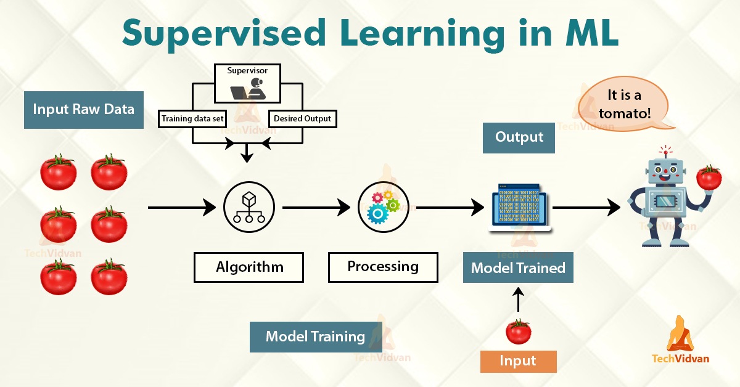
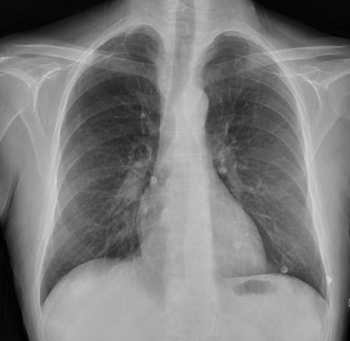
NORMAL / PNEUMONIA
Input

Slide 5
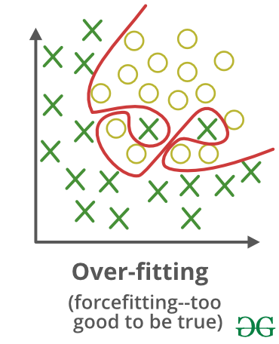
OVERFITTING
When the model has been overtrained ,the nodes have end up "memorizing" the input data. This results in a high variance, i.e. a significant difference between the error of the train set and the test set.
Overfitting happens when a model learns the detail and noise in the training data to the extent that it negatively impacts the performance of the model on new data. The model begins to treat random fluctuations and noise as concepts.
TO AVOID OVERFITTING
Train a bigger neural network architecture and get more data.
Try out regularisation.

Slide 6
REGULARISATION
L1 and L2 are the most common types of regularization. These update the general cost function by adding another term known as the regularization term.
Cost function = Loss (say, binary cross entropy) + Regularization term
The regularization term differs for L1 and L2 type regularization:
L2 Regularisation: L2 regularization is also known as weight decay as it forces the weights to decay towards zero.
L1 Regularisation: In this, we penalize the absolute value of the weights. Unlike L2, the weights may be reduced to zero here. Hence, it is very useful when we are trying to compress our model. Otherwise, we usually prefer L2 over it.
OPTIMISATION
Choosing the correct optimization configuration of our neural network will allow us to reduce the difference between the prediction obtained and the correct value.
The function of the optimizer is to update the weights of the nodes in order to minimize the error of the cost function.

Slide 7
LEARNING RATE AND DROPOUT
Learning Rate :
It is one of the hyperparameters that most affects the training process. A learning rate too small gives rise to a very slow convergence, while a learning rate that is too high cause divergence.
It is important to start with a sufficiently high learning rate and reduce it as the model converges to global optimum.
Dropout :
Let’s say we have a neural network that’s overfitting. With dropout, we go through each of the layers of the neural networks and set some probability of eliminating a node in a neural network.
Dropout forces a neural network to learn more robust features that are useful in conjunction with many different random subsets of the other neurons.

Slide 8
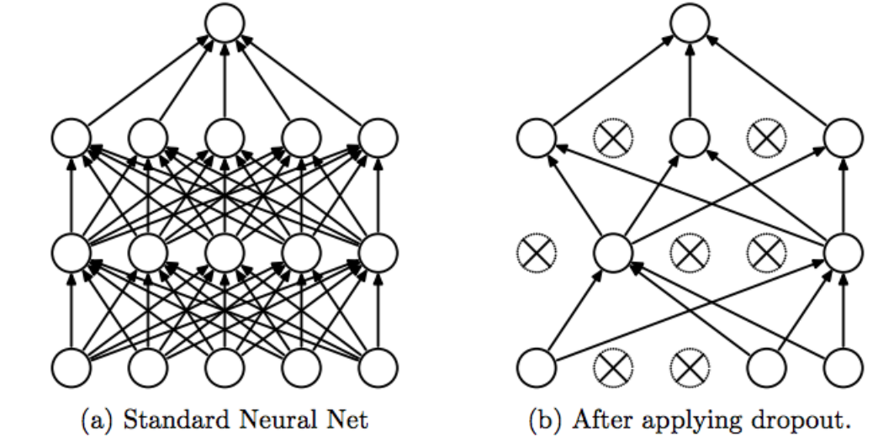

Slide 9
MAJOR LIBRARIES USED:
Tensorflow
Keras
Matplotlib
Pandas
Numpy

Slide 10
DATASET DESCRIPTION
We have collected our dataset from Chest X-Ray Images (Pneumonia) | Kaggle.
Our dataset consists of a total of 5856 frontal-view of Chest X-Ray images which has been splitted approximately in a 90-10% ratio.
Name of Sets | Total Number of Images | Pneumonia (Target: 1) | Normal (Target: 0)
Training Set | 5216 | 3875 | 1341
Test Set | 624 | 390 | 234
Validation Set | 16 | 8 | 8
Total | 5865 | 3673 | 1583

Slide 11
IMAGE AUGMENTATION
In order to increase the size of the training data set we have the possibility to apply certain transformations to the existing training data. This artificial way of creating extra training images through different ways of processing is called image augmentation.

Slide 12
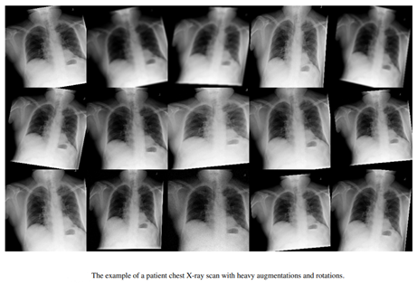

Slide 13
The original 3-channel images were resized into 150×150 pixels to reduce the heavy computation and for faster processing.
The ‘rescale’ option helps in reducing the size or magnification of the image (rescale=1./255)
Randomly rotation of the images during training is by 40 degrees.
Added a width shift (horizontal translation) and height shift(vertical translation) of 0.2%.
A shear range and a zoom range of 0.2 were also added.
Finally the images were flipped horizontally. We are not flipping the images vertically as there is no upside down Chest-Xray

Slide 14
THE CNN ARCHITECTURE
A CNN (Convolutional Neural Network) is a subset of ANN (Artificial Neural Network), the working of which is heavily influenced by the working of the human brain.
CNNs are adept in handling large amounts of data and produce results with higher accuracy in certain tasks like pattern recognition.
Derives its name from the operation of “convolution” between matrices of any dimensions.

Slide 15
IMPLEMENTATION OF CNN IN THE MODEL:
Use of filters:
A filter is a matrix of size 3x3 or 5x5, and is used to determine the effect of a nearby pixel using “convolutions”
The filter slides over the image in a left to right and then top to bottom manner, determining the effect of the pixels
Use of filters is essential for our model as it highlights the important features in a chest X-ray which help us in determining if the lung is infected. These highlighted features help our model learn, and produce accurate results.

Slide 16
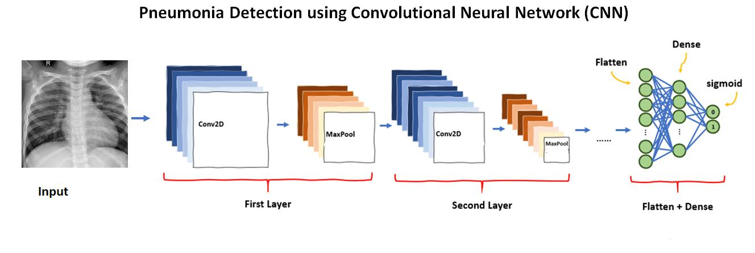

Slide 17
IMPLEMENTATION: Conv2D layers
The diagram shows the working of a Conv2D
layer. The Conv2D layer is responsible for the
computation of convolutions, with the use of
the filters described in the previous slide.
The filter (or kernel) is a randomly initialised
matrix, which is responsible for computing the
“Impact” of a group of pixels in extraction of features.
Our model contains a total of 5 Conv2D layers.

Slide 18
IMPLEMENTATION: MaxPooling2D layer
The diagram alongside shows the working of a
MaxPooling2D layer, as used in our model. An
empty matrix of dimensions 3x3 slides over the
pixels of our image and selects the pixel with the
maximum value. We have used a MaxPool2D of
dimensions 2x2, which results in the effective decrease of the image size to 75% of the
original dimension.
Our model contains a total of 5 MaxPooling2D layers.

Slide 19
IMPLEMENTATION: FC Layers
There are 2 FC (Fully Connected) layers that have been used in our model:
Flatten
The Flatten layer is used after the pooled feature map is obtained. The entire pooled feature map is flattened into a single column and fed to the neural network.
Dense
The purpose of a Dense layer is to feed all inputs from the previous layer of neurons to the present layer of neurons, thus, making it a fully connected layer.

Slide 20
RESULTS
We have trained our model upto 10 epochs with steps per epoch = 500 since the number of images in the training set is 5216 (No. of images = Batch size(10) X No. of Steps) and no. of validation steps = 62. On obtaining the accuracies, we plot graphs in order to visualise the success rate of our model using matplotlib.
We obtained an accuracy of 90.29% on the train set (containing 5216 images) and an accuracy of 82.50% on the test set (containing 624 images)

Slide 21
Validation Accuracy: 82.50 %
Epoch 1/10
500/500 [==============================] - 330s 660ms/step - loss: 0.8998 - acc: 0.7416 - val_loss: 1.0060 - val_acc: 0.6242
Epoch 2/10
500/500 [==============================] - 305s 610ms/step - loss: 0.6764 - acc: 0.7674 - val_loss: 0.6723 - val_acc: 0.7645
Epoch 3/10
500/500 [==============================] - 321s 642ms/step - loss: 0.5189 - acc: 0.8413 - val_loss: 0.5669 - val_acc: 0.8677
Epoch 4/10
500/500 [==============================] - 348s 696ms/step - loss: 0.4188 - acc: 0.8671 - val_loss: 0.5221 - val_acc: 0.7903
Epoch 5/10
500/500 [==============================] - 339s 678ms/step - loss: 0.3563 - acc: 0.8829 - val_loss: 0.6117 - val_acc: 0.8532
Epoch 6/10
500/500 [==============================] - 387s 774ms/step - loss: 0.3250 - acc: 0.8871 - val_loss: 0.3896 - val_acc: 0.8871
Epoch 7/10
500/500 [==============================] - 426s 851ms/step - loss: 0.2966 - acc: 0.8915 - val_loss: 0.3851 - val_acc: 0.8726
Epoch 8/10
500/500 [==============================] - 302s 604ms/step - loss: 0.2748 - acc: 0.9009 - val_loss: 0.3968 - val_acc: 0.8435
Epoch 9/10
500/500 [==============================] - 255s 510ms/step - loss: 0.2592 - acc: 0.9049 - val_loss: 0.3462 - val_acc: 0.9081
Epoch 10/10
500/500 [==============================] - 240s 480ms/step - loss: 0.2592 - acc: 0.9025 - val_loss: 0.3757 - val_acc: 0.8887

Slide 22
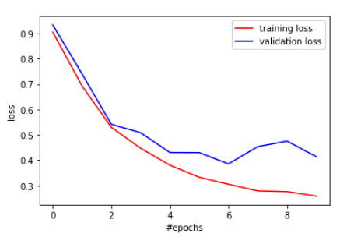
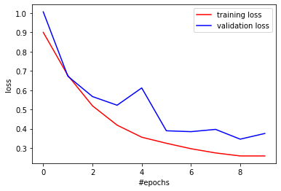
TRAINING LOSS AND VALIDATION LOSS PLOTTED AS NO. OF EPOCHS VS LOSS

Slide 23
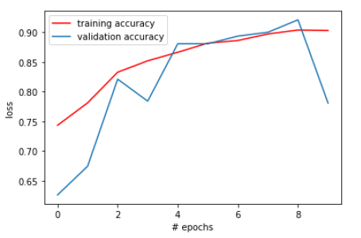
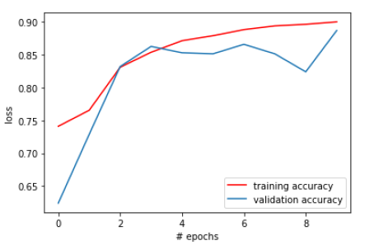
TRAIN ACCURACY AND VALIDATION ACCURACY PLOTTED AS NO.OF EPOCHS VS LOSS

Slide 24
THANK YOU

